Slide 1
App in a Day
Microsoft Power platform
PowerApps
Microsoft Flow
Power BI
Common Data Service for Apps

Slide 2
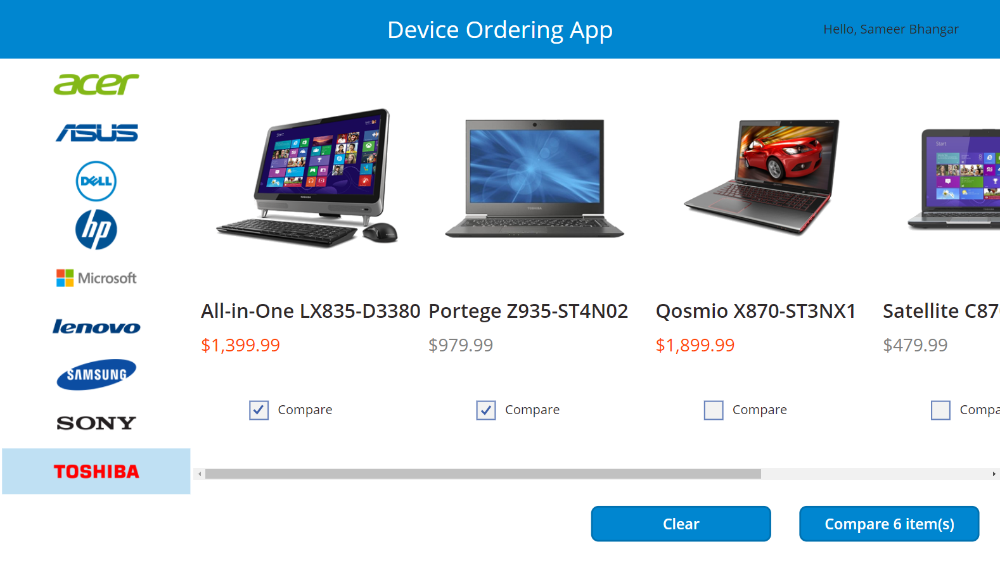
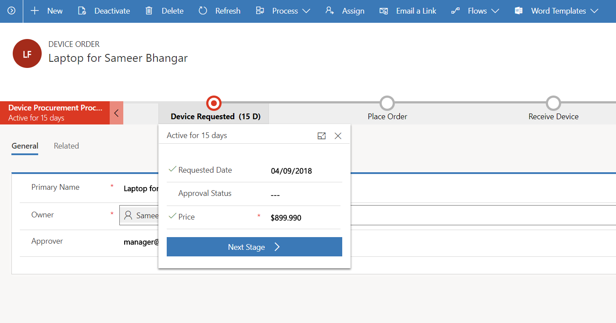
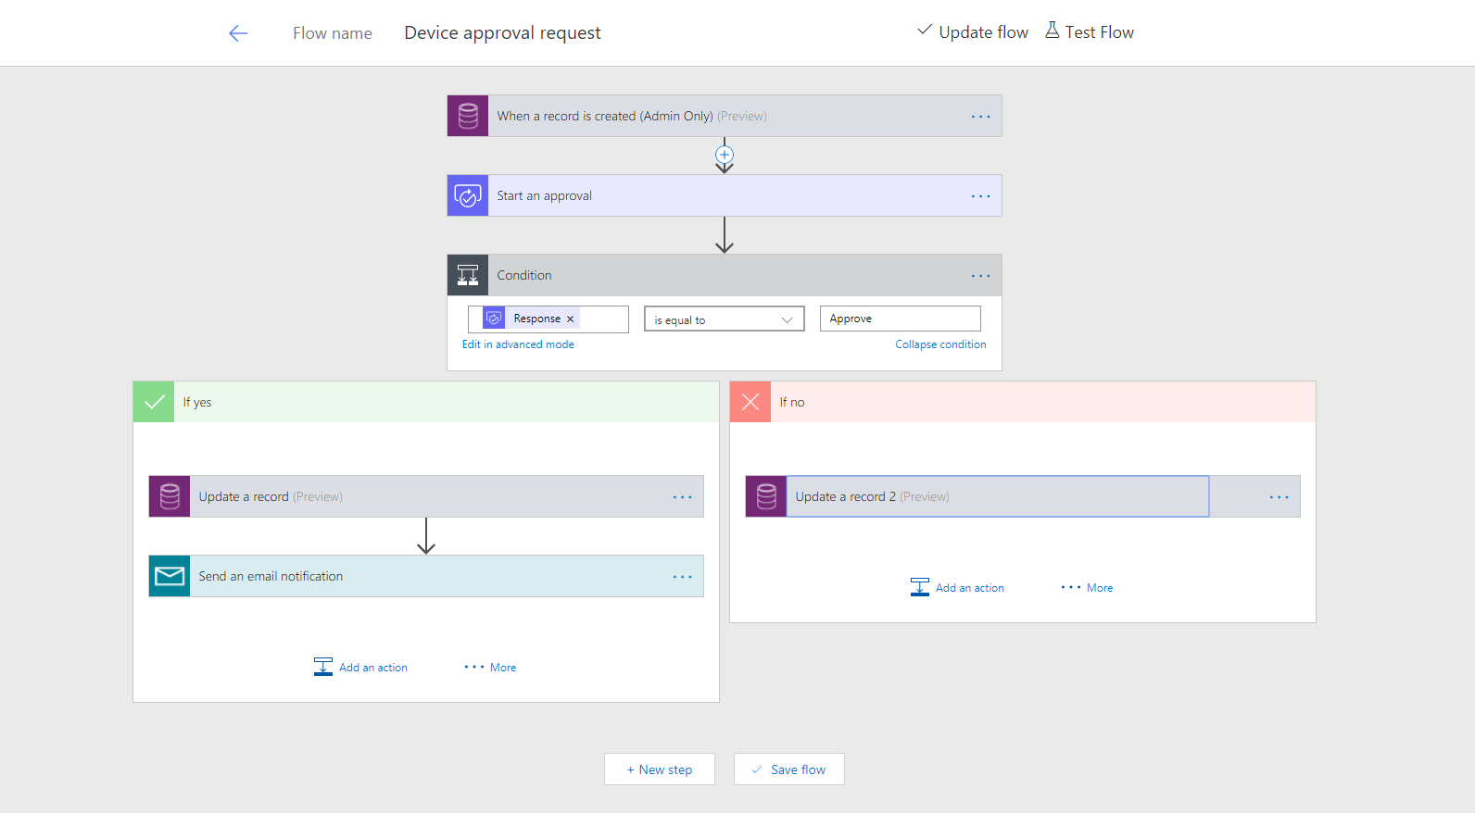
Business scenario
Imagine an organization where every three years employees go through a hardware refresh cycle.
They would like to streamline the device order, procurement and approval process and view aggregate reports
The employee facing device ordering app needs to run in a web browser and on mobile devices

Slide 3
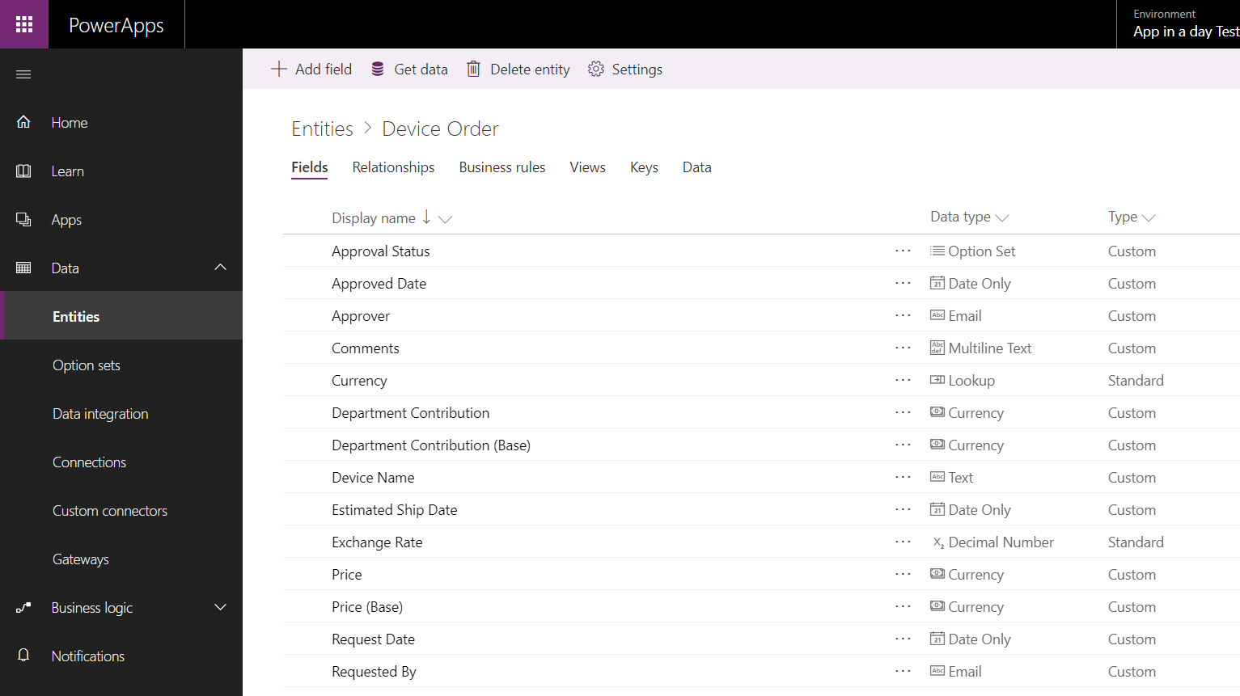
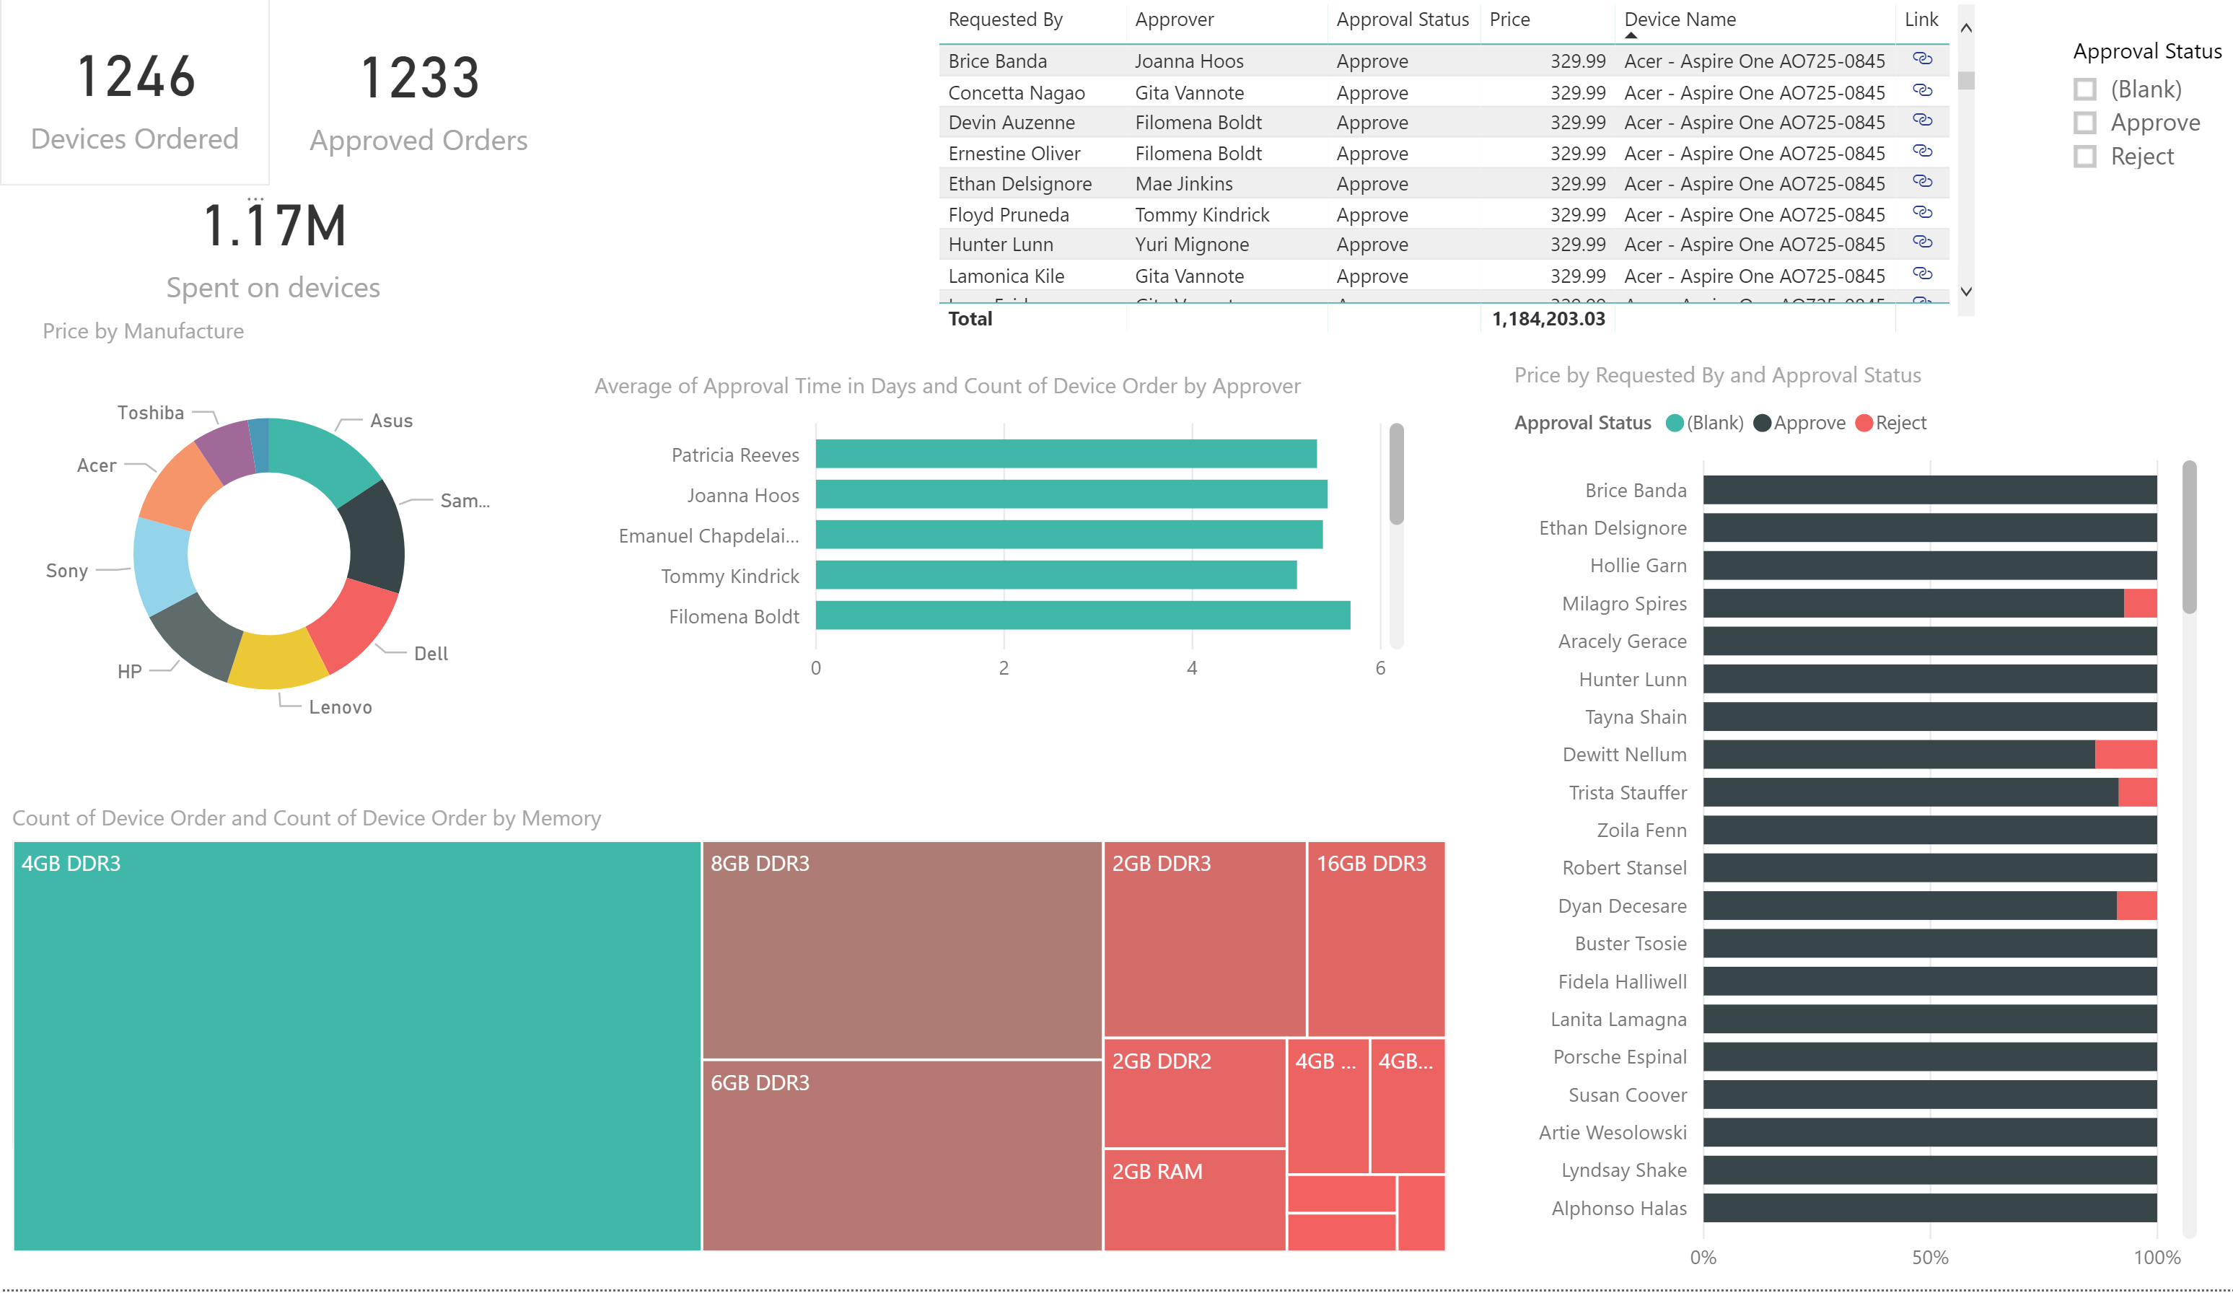
Lab objectives
Build a PowerApps Canvas App for employee facing device ordering experience
Use the Common Data Service for Apps (CDS for Apps) to store the device orders in the cloud
Build a PowerApps Model-driven App to complete the procurement process
Use Microsoft Flow to build an approval workflow for device approval
Use Power BI to visualize device order data

Slide 4
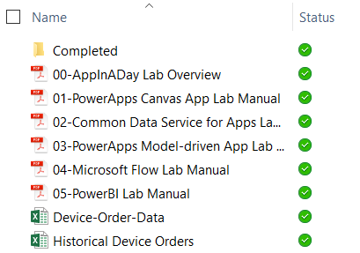
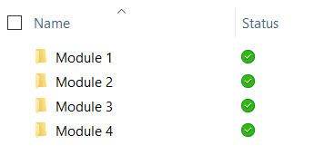
Lab content
Lab docs:
Package: http://aka.ms/appinaday
Unzip the package on your local machine
Follow instructions: “00-AppinaDay Lab Overview.pdf”
Contains 5 modules with a lab doc for each:
01-PowerApps Canvas App
02-Common Data Service for Apps
03-PowerApps Model-driven App
04-Microsoft Flow
05-Power BI
Completed Modules:
The \Completed folder contains solution packages that you can import
e.g. To work on Module 5 without completing previous modules -> see \Completed\Module4
Completed modules:

Slide 5
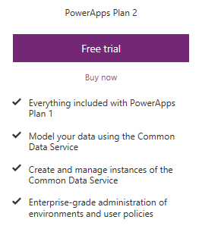
Pre-requisites
Valid PowerApps Plan 2 license:
Common Data Service usage requires a PowerApps Plan 2 license
Visit https://powerapps.microsoft.com/pricing/ and click Free Trial
If you are unable to acquire a trial license:
Ask the instructor for a trial user account that you may use for this session OR
Create your own Office 365 trial tenant – http://aka.ms/Office365E5Trial
PowerApps authoring environment:
Launch https://web.powerapps.com using any modern browser
PowerApps mobile apps (Optional):
PowerApps – iOS : https://aka.ms/PowerAppsiOS
PowerApps – Android : https://aka.ms/PowerAppsAndroid

Slide 6
Provision environment and Common Data Service
This lab requires a new PowerApps environment and CDS database that was provisioned after Apr 1, 2018.
Go to the PowerApps Admin center – http://admin.powerapps.com
Select +New environment, fill out the form and select Create
Select the Create database option
Fill out the form and select Create database
You will be taken to a screen that shows the newly created environment
IMPORTANT: The database has not yet been provisioned
Select the environment you just created
Wait for the “Provisioning database…” message to go away
You may need to refresh the screen every couple of minutes
Once the provisioning is complete, then proceed to create apps in the environment

Slide 7
Module 1: PowerApps Canvas App
Hands-on-lab

Slide 8
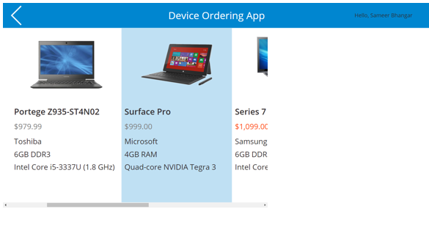
Learning objectives
Sign-in and create a new Canvas App
Connect to data sources
Filter data
Work with multiple screens and navigation
Customize the user experience – galleries and controls

Slide 9
Module 2: Common Data Service for Apps
Hands-on-lab

Slide 10
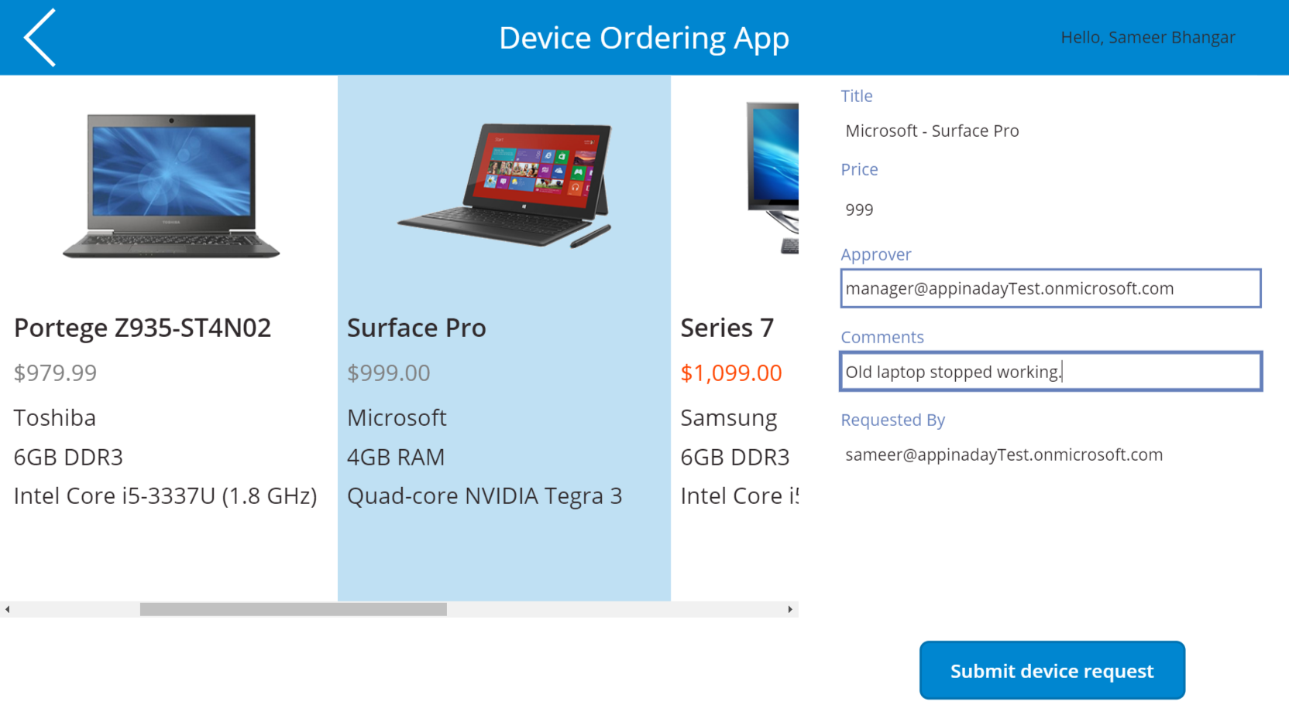
Learning objectives
Provision a CDS database
Get familiar with standard entities
Create a custom entity
Customize entity fields and option sets
Create calculated fields
Use the Canvas app form control to save data to CDS
Use the Office365 connector to get user’s manager info
Configure Canvas app settings
Save and share a Canvas app
Run a Canvas app on a mobile device

Slide 11
Module 3: PowerApps Model-driven App
Hands-on-lab

Slide 12
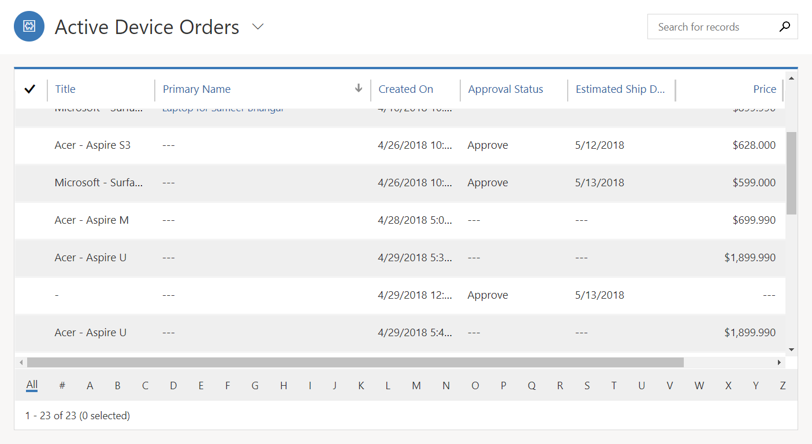
Learning objectives
Create a standalone Model-driven app
Customize forms for the Model-driven app
Create a Business Process Flow

Slide 13
Module 4: Microsoft Flow
Hands-on-lab

Slide 14
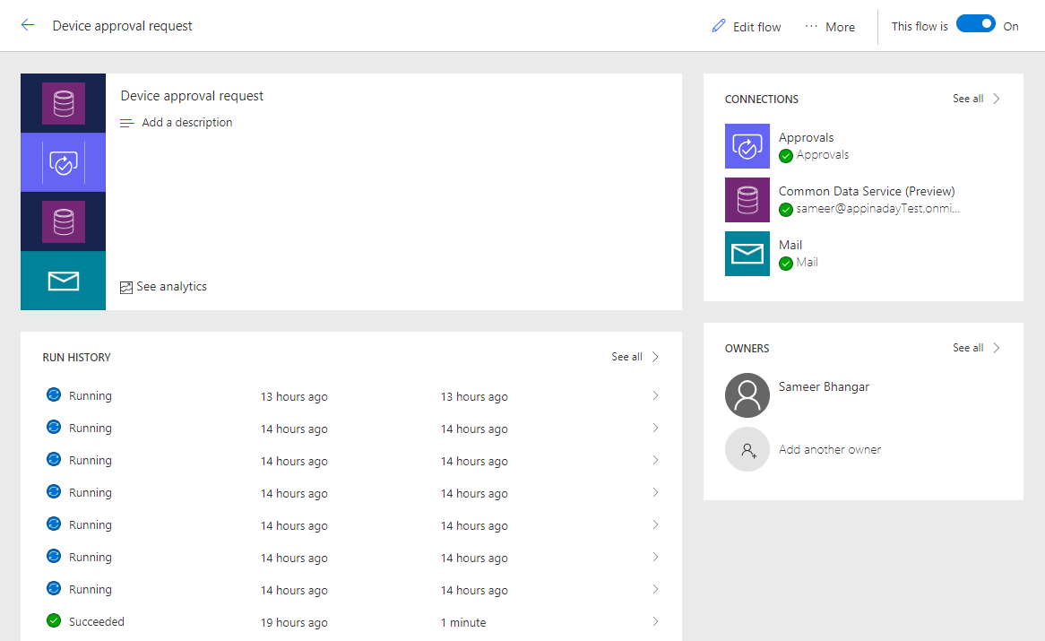
Learning objectives
Trigger a Flow when a new record is created in CDS
Send an approval request
Conditional branching based on the approval response
Send email notifications
Update the CDS record with the approval status and the approver’s comments
Use the approval center on web and mobile
Check the status of Flow runs

Slide 15
Module 5: Power BI
Hands-on-lab

Slide 16
Learning objectives
Connect Power BI to the Common Data Service
Transform CDS data for use in visualizations
Create visualizations on the CDS data
Combine CDS data with other data sources

Slide 17
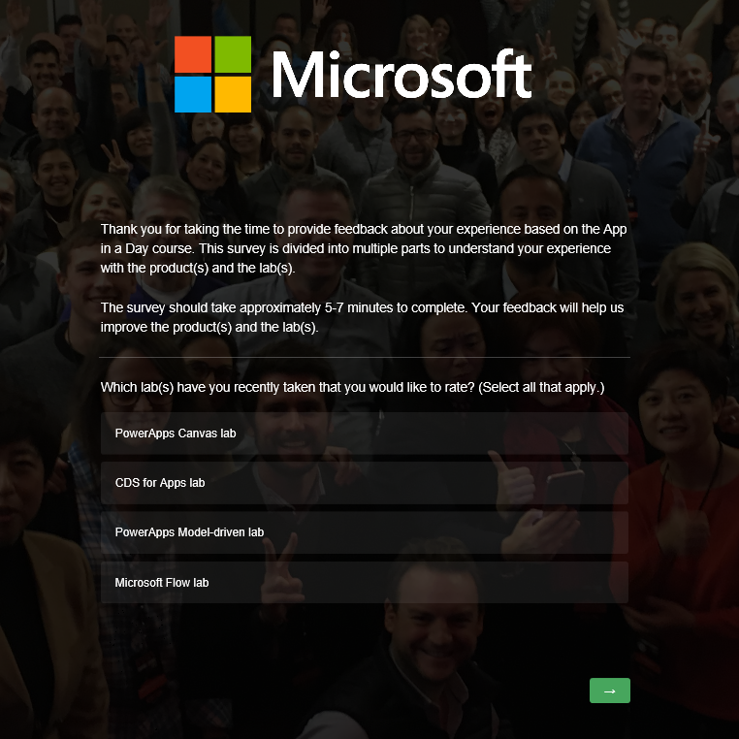
Lab survey
http://aka.ms/appinadayLabSurvey

Slide 18
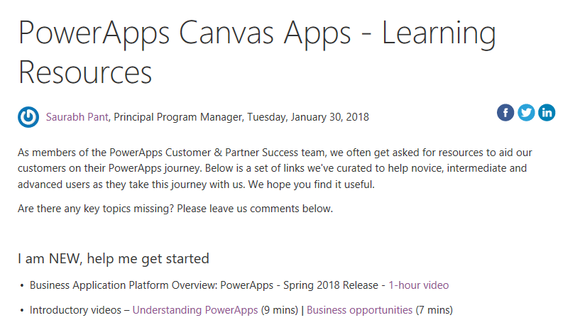
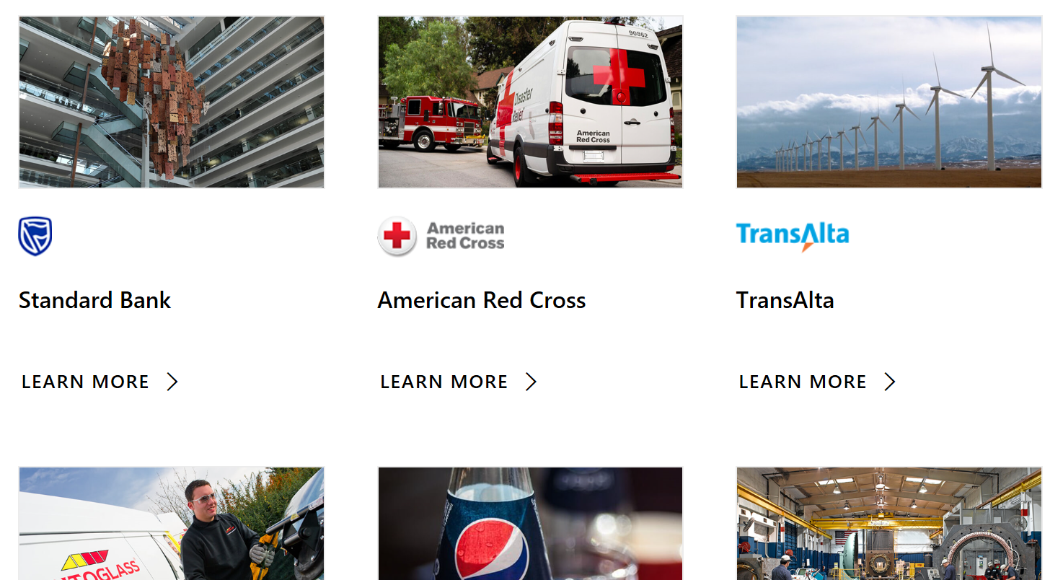
Learning resources
http://aka.ms/powerapps-resources
http://aka.ms/flow-resources
Customer stories
http://aka.ms/PowerAppsStories
http://aka.ms/GJPepsiVideo
http://aka.ms/ArrivaVideo
http://aka.ms/HeathrowVideo

